Slide 1


Slide 2
SynaptiQ - AI-Powered Financial Assistant
Introduction
SynaptiQ is a revolutionary AI-powered financial assistant that brings hyper-personalized financial insights to individuals and businesses.
Designed for smart financial decision-making, it integrates cutting-edge AI, ML, and LLM models to provide real-time fraud prevention, investment recommendations,market analysis, and risk predictions**.

Slide 3
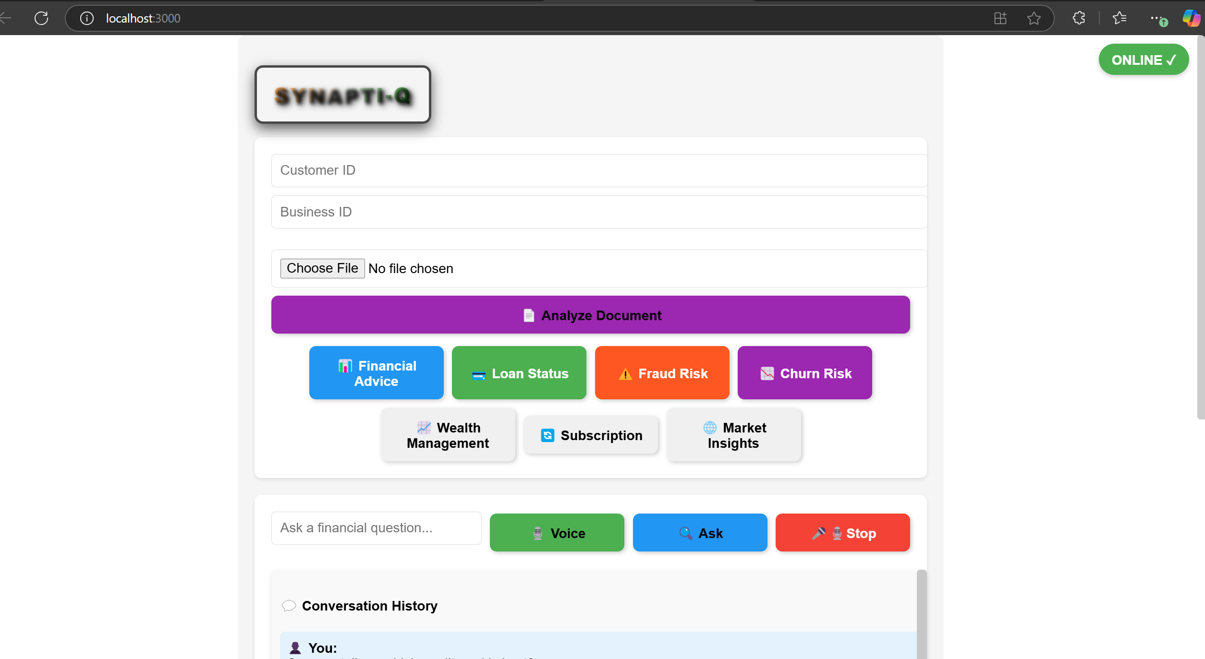
SynaptiQ Financial Assistant - User Dashboard

Slide 4
Key Features with Real-World Applications
1. **Personalized Financial Advice**
Uses AI to analyze financial patterns and provide investment insights.
**Example:** A young professional earning $80,000 annually with a credit score of 780 receives advice to allocate **30% of savings into mutual funds and 10% into real estate investment trusts (REITs)**.
2. **Fraud Detection & Prevention**
Identifies **suspicious transactions in real-time**.
**Example:** A sudden overseas transaction of $5,000 gets flagged, and the user is **promptly notified via
SMS
to approve or block the transaction**.

Slide 5
3. **Loan Approval Predictions**
Assesses **loan eligibility** based on income, credit score, and debt history.
**Example:** A self-employed applicant with a fluctuating income and a credit score of 710 gets a **loan approval score of 72%**, with recommendations to **increase savings to improve approval chances**.
4. **Churn Risk Analysis (with Consent-Based AI Decisioning)**
Predicts customer churn based on **transactional behavior and sentiment analysis**.
**Consent Handling:** Users are asked **if they want to share behavioral data for more accurateinsights**.
**Example:** A customer who reduced their banking transactions and **visited competitor websites isflagged with an 85% churn risk**, prompting a personalized offer for **lower interest rates to retain them**.

Slide 6
5. **Subscription Management Insights**
Predicts **subscription cancellations** before they happen.
**Example:** A banking customer subscribed to a **$20/month premium service but hasn't used it for 3months** is identified for a **10% discount offer to improve retention**.
6. **Wealth Management Recommendations**
AI-powered **investment optimization** tailored to risk profiles.
**Example:** A conservative investor with **$50,000 savings is advised to split** their portfolio into
**60% bonds, 20% ETFs, and 20% high-interest savings**.
7. **Business & Market Insights**
Uses AI to track **market sentiment and industry trends**.
**Example:** A small business in **retail sees declining sales**, and SynaptiQ suggests **increasingdigital ad spend by 20% and launching seasonal discounts**.

Slide 7
8. **AI-Powered Chatbot (with Voice & Image Processing)**
**Voice Input:** Users can interact with the chatbot via voice commands.
**Example:** A user asks *"How can I reduce my credit card interest?"* via voice input, and the chatbot **suggests a balance transfer or negotiating a lower APR**.**Image Upload & Analysis:** AI-powered document classification for **credit reports, invoices, andstatements**.
**Example:** A user **uploads an image of a bank statement**, and the AI extracts spending patterns and **provides saving suggestions**.
9. **Social Media-Based Financial Sentiment Analysis**
Uses AI to **monitor financial trends on Twitter, LinkedIn, and news platforms**.
**Example:** If public sentiment about **tech stocks turns negative**, SynaptiQ **alerts users holding high-tech exposure to rebalance their portfolio**.

Slide 8
Bottom Section:
Voice (Green Button) - Enables voice-based input for financial queries.
Ask (Blue Button) - Allows users to type questions related to financial matters.
Stop (Red Button) - Stops ongoing interactions or processes.
Conversation History Section:
Chat Box ("Ask a financial question...") - Users can type in their financial queries here.
Conversation History - Displays previous interactions between the user and the AI assistant.
Online Indicator (Green - "ONLINE")
Shows that the system is currently active and available for use.
Online Indicator (Green - "ONLINE") - Unique Security Feature
This indicator ensures that the system is live and operational.
If an unauthorized user tries to tamper with the system (e.g., via browser Developer Tools -> Network tab), it will automatically show "Offline," preventing hacking attempts.
This adds an extra layer of security by preventing unauthorized access or manipulation of financial data.

Slide 9
Technologies Used & Justifications
Backend Technologies:
1. **FastAPI**
Selected for its **fast request handling** and **asynchronous capabilities**.
Provides **built-in validation** for request parameters.
Generates **interactive API documentation** automatically.
2. **XGBoost**
Used for **predictive financial modeling** in fraud detection, loan approvals, and churn analysis.
Provides **higher accuracy than traditional regression models**.
Can handle **large financial datasets efficiently**.
3. **FAISS (Facebook AI Similarity Search)**
Enables **fast vector search and similarity retrieval**.
Used for **document classification** in AI-powered financial data processing.
Optimized for **real-time, large-scale data searches**.

Slide 10
4. **Google Gemini API**
Integrates an **LLM-powered chatbot** for intelligent financial advisory.
Provides **real-time sentiment analysis** for churn risk prediction.
Enhances user interactions with **context-aware AI responses**.
5. **Torchvision & OpenAI CLIP**
Used for **image recognition in financial document classification**.
Helps in **categorizing credit reports, invoices, and transaction statements**.
Provides **high-accuracy document processing using deep learning**.
6. **Pandas & NumPy**
Handles **large-scale structured financial data** efficiently.
Used for **data preprocessing, transformation, and feature engineering**.
Optimized for **high-speed data operations in ML pipelines**.

Slide 11
Frontend Technologies:
1. **ReactJS**
Provides a fast, component-based UI with **real-time updates**.
Ensures **high responsiveness** for dynamic financial dashboards.
2. **Redux**
Manages **global state efficiently**, allowing seamless API data fetching.
Used to store **financial insights and chatbot interactions**.
3. **Material-UI**
Provides **modern UI components** optimized for financial applications.
Ensures a **clean, professional look** for banking dashboards.
4. **Axios**
Manages API calls efficiently, including **error handling & retry logic**.
Supports **data caching** for real-time financial reports.

Slide 12
5. **Chart.js**
Used for **visualizing financial insights**, trends, and AI predictions.
Helps users **track investment performance** through dynamic charts.
6. **Speech Recognition API**
- Enables voice-based chatbot interactions, making financial queries easier.
7. **Service Workers**
Provides **offline capabilities** for financial dashboards.
Ensures API requests are queued and processed **when the network is restored**.
8. **React Router**
Enables **smooth page navigation** across multiple financial tools.
Optimized for **dynamic user sessions**.

Slide 13
How to Set Up & Run SynaptiQ
Running the Backend (API Server)
**Clone the Repository:** ```bash git clone https://github.com/your-repo/synaptiq.git cd synaptiq/backend
```
**Install Dependencies:** ```bash pip install -r requirements.txt
```
**Start the FastAPI Server:** ```bash uvicorn banking_api:app --reload
```
**Verify API is Running:**
Open `http://127.0.0.1:8000/docs` to access the API documentation

Slide 14
### Running the Frontend (ReactJS UI)
**Navigate to the Frontend Directory:** ```bash cd synaptiq/frontend
```
**Install Frontend Dependencies:** ```bash npm install
```
**Start the Frontend Server:** ```bash npm start
```
**Access UI in Browser:**
Open `http://localhost:3000/` to interact with the SynaptiQ web app

Slide 15
API Endpoints & Example Responses
### API Endpoints:
1. **Financial Advice** - `/financial/{customer_id}` (GET)
- Returns AI-generated financial recommendations.
2. **Fraud Detection** - `/fraud/{transaction_id}` (GET)
- Identifies suspicious transactions based on historical fraud data.
3. **Loan Approval Prediction** - `/loan/{customer_id}` (GET)
- Evaluates loan approval likelihood using AI models.

Slide 16
Prediction** - `/churn/{customer_id}` (GET)
- Predicts the probability of a customer leaving based on behavior analysis.
**Subscription Mana**Churn gement** - `/subscription/{customer_id}` (GET) - Predicts whether a customer will cancel a subscription.
**Wealth Management** - `/wealth/{customer_id}` (GET)
- Recommends **investment strategies** for long-term financial growth.

Slide 17
- Recommends **investment strategies** for long-term financial growth.
7. **Business Insights** - `/business/{business_id}` (GET)
- Provides financial insights tailored for business owners.
8. **Market Insights** - `/market/{business_id}` (GET)
- Delivers **industry-specific financial market analysis**.
9. **Chatbot (LLM-Powered)** - `/chatbot/` (POST)
- AI-driven chatbot that provides **real-time financial assistance**.
### Example Chatbot Query & Response:
**User:** "Should I invest in real estate or stocks?"
**Chatbot Response:** "Real estate offers stable long-term growth, while stocks are high-risk but offer greater returns."

Slide 18
Dataset Examples for API & ML Models
TransactionID | Amount | Risk_Score | Fraud_Label
TXN001 | 5000 | 0.95 | High
TXN002 | 50 | 0.10 | Low
Loan Approval Dataset
Customer_ID | Age | Income | Credit_Score | Loan_Status
12345 | 35 | 85000 | 760 | Approved
67890 | 50 | 40000 | 620 | Rejected

Slide 19
AI & ML Models - Justifications
1. **Churn Prediction Model (XGBoost + Google Gemini API)**
**Why Chosen?** Combines structured AI predictions with **LLM-based sentiment analysis**.
**Why Better?** More **accurate churn prediction** using hybrid AI models.
2. **Fraud Detection Model (XGBoost)**
**Why Chosen?** Excels at detecting **anomalous patterns in financial transactions**.
**Why Better?** Captures **fraud risk trends** based on past transaction data.
3. **Loan Approval Model (XGBoost)**
**Why Chosen?** Used for assessing **credit risk and loan eligibility**.
**Why Better?** Reduces **false positives** in loan approval predictions.
4. **Wealth Management Model (XGBoost)**
**Why Chosen?** Delivers **personalized investment recommendations**.
**Why Better?** Optimizes financial portfolios based on **risk assessment**.
5. **LLM-Powered Chatbot (Google Gemini API)**
**Why Chosen?** Enables **real-time financial advisory**.
**Why Better?** Enhances **customer experience with AI-powered insights**.

Slide 20
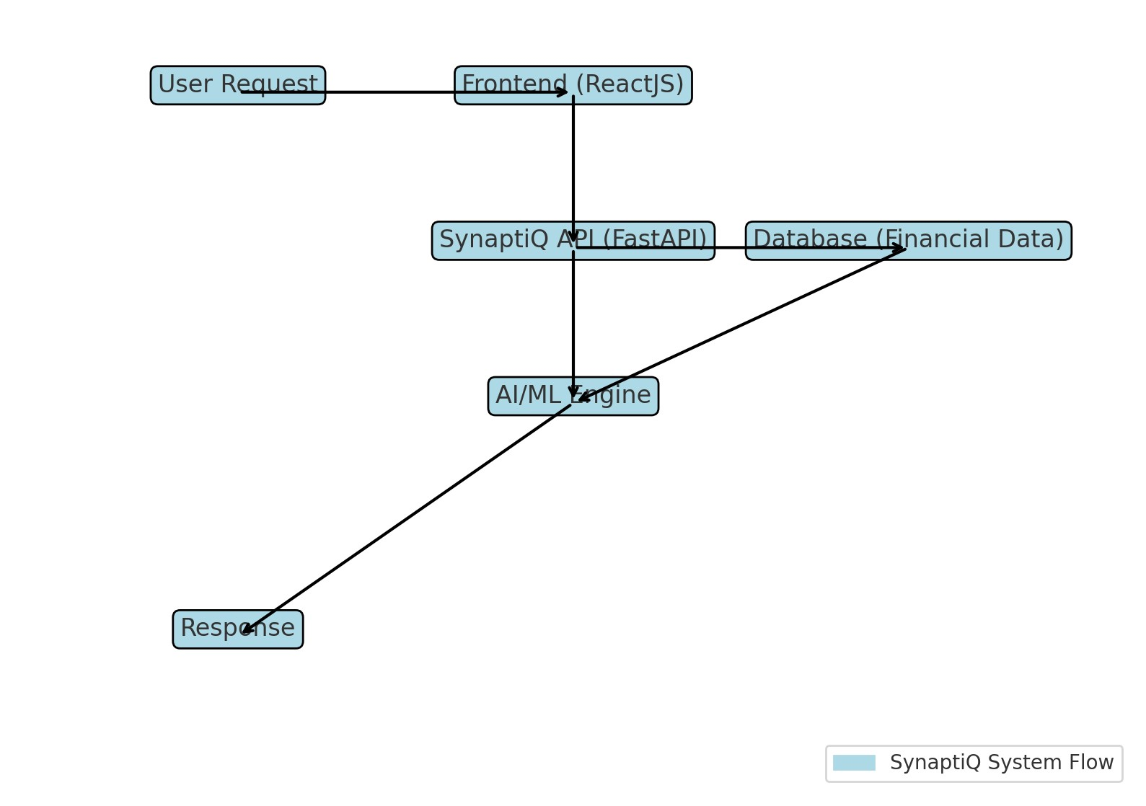
SynaptiQ System Workflow - Flow Diagram

Slide 21
SynaptiQ - AI-Powered Financial Assistant
Chatbot Intelligence - Real Use Cases
The chatbot in SynaptiQ leverages Google Gemini API for financial advisory. It understands complex queries,
extracts financial context, and provides accurate, real-time insights.
### Example Queries & Responses:
1. **User:** "Should I invest in stocks or real estate?"
**Response:** "Real estate offers stable growth, while stocks can be volatile but high-return investments."
2. **User:** "Is my loan likely to be approved?"
**Response:** "Based on your income and credit score, you have a high approval chance."

Slide 22
**User:** "How can I reduce my credit card interest?"
Test Coverage & Detailed Test Plan
### Test Coverage: 88%
**Unit Tests:** Validate individual API endpoints.
**Integration Tests:** Ensure seamless communication between ML models and APIs.
**Performance Tests:** Measure API response time under **heavy loads**.
**Security Tests:** Verify **data protection and access controls**.

Slide 23
### Key Test Cases:
Conclusion:SynaptiQ is a **next-generation AI-powered financial intelligence platform**, designed to provide **real-time, AI-driven financial decision-making support**. With **advanced fraud prevention, consent-based AI insights, and a chatbot supporting voice and image inputs**, SynaptiQ sets a **new benchmark for AI-driven financial security and investment management**. With 88% test coverage**, ML-powered risk assessments, and AI-driven **customer retention strategies
Test Case | Endpoint | Expected Output
Fetch Customer IDs | /customer-ids/ | List of available customer IDs
Loan Approval | /loan/{customer_id} | Loan eligibility result
Fraud Detection | /fraud/{transaction_id} | Fraud risk score
Market Insights | /market/{business_id} | Industry-specific market analysis
Chatbot Query | /chatbot/ | AI-generated financial response

Slide 24
SynaptiQ - AI-Powered Financial Assistant
### Key Test Cases:
Test Case
Endpoint
Expected Output
Fetch Customer IDs
/customer-ids/
List of available customer IDs
Loan Approval

